Slide 1
William Stallings Computer Organization and Architecture 10th Edition
Chapter 4
Cache Memory

Slide 2


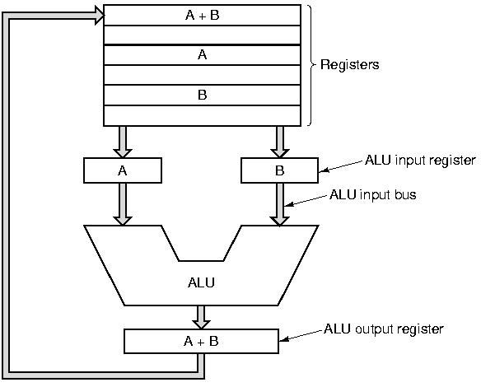
Review
Computer architecture
Computer Organization
how features are implemented
Instruction set,
addressing
Is there a multiply instruction?

Slide 3
Review
The hierarchical nature of most complex systems
Computer
CPU
Register
ALU
Memory
I/O
Top
Level 1
Level 2
Control Unit
At each level, the designer is concerned with structure and function.
Top
-
down
Structure is the way in which components are interrelated.
All computer functions are:
1) Data processing
2) Data storage
3) Data movement
4) Control
Function is the operation of individual components as part of the structure.

Slide 4
Consider from key points
What is the hierarchical organization of computer memory?
What are the characteristics of memory hierarchy from top down?
What is the cache for?
Notes:
要点：
- 计算机存储器的层级结构是什么样的？
存储器层级结构 自顶向下的特征？
- Cache有什么用？

Slide 5
Key points
Computer memory is organized into a hierarchy. (*processor registers← L1 (L2…) cache← main memory← external memory)
Decreasing cost/bit, increasing capacity, slower access time
Locality of reference makes proper designs of cache improve computer performance
Notes:
板书：processor registers← L1 (L2…) cache← main memory← external memory
Cost/bit：
Capacity:
Access time:
Locality:

Slide 6
4.1 Computer memory system overview
Characteristics of memory systems
The memory hierarchy

Slide 7
Characteristics
Location
Capacity
Unit of transfer
Access method
Performance
Physical type
Physical characteristics
Organization
Notes:
传送单位unit of transfer：
对于主存，就是每次读/写数据的位数，经常是一个字或者一个寻址单元；
对于外存，通常是一个块，比一个字大得多；

Slide 8
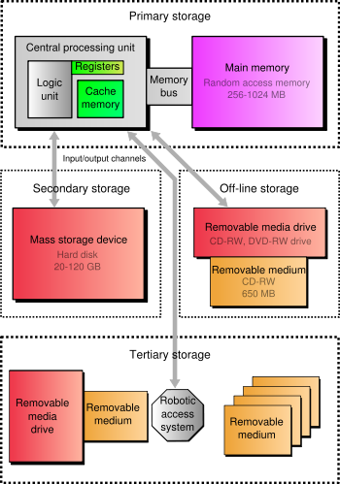
Location
CPU:
Register, Control memory
Internal
Cache, Main memory
External
Disk, Tape, CD, DVD

Slide 9
Capacity
Word size
The natural unit of organisation
Intel x86：word size=32bits
Number of words
or Bytes
Capacity=Word size * Number of words

Slide 10
Addressable unit
Addressable unit
Smallest location which can be uniquely addressed
Word or byte
Address length :A bits
the number N of addressable units is 2^{A} =N
32bits, N=2³²
Notes:
可寻址单位Addressable unit：
某些系统，可寻址单位是字；多数系统，可寻址单位是字节，
地址长度A，可寻址单位数N=2^A (板书)

Slide 11
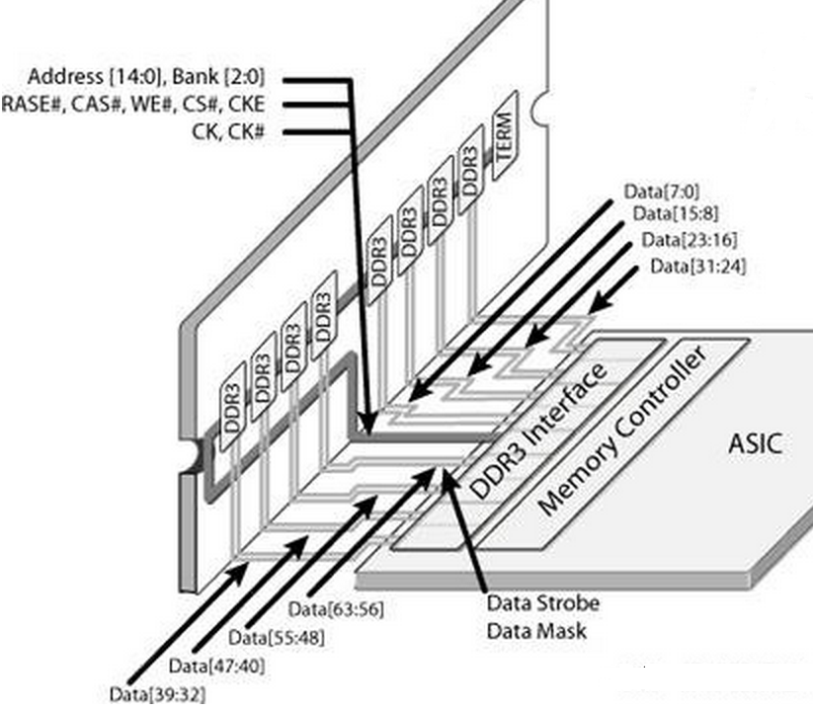
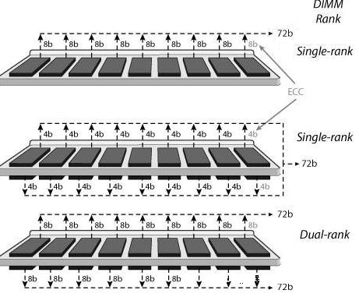
Unit of Transfer
Main memory
Usually governed by data bus width (Byte, Word)
Usually a block which is much larger than a word (Block)
data bus width=64bits
Notes:
传送单位unit of transfer：
内存，由数据总线决定（字节 或 字）；每次读/写主存的位数，不一定等于一个字或寻址单位；
比如PC中，DDR2 和CPU之间总线64位，可以由4块16位的DDR2芯片组合，也可以由8块8位的芯片组合。（板书画图）
外存，通常是一个块，比一个字大得多；

Slide 12

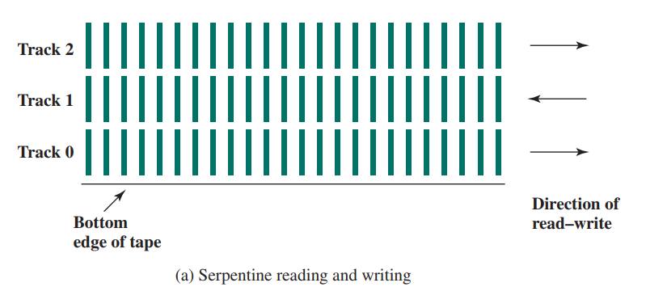
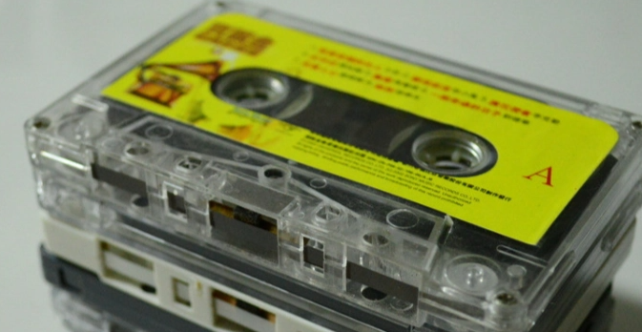
Access Methods (1)
Sequential
Direct
Start at the beginning and read through in order
Access time is highly variable and depends on location of data and previous location
e.g. tape
Individual blocks have unique address
Access is by jumping to vicinity plus sequential search
Access time depends on location and previous location
e.g. disk
Notes:
顺序存取：以特定的线性顺序方式存取，
存取不同记录的时间相差很大，比如磁带系统。
直接存取：单个快有唯一地址，存取=〉跳到块附近 + 顺序搜索；硬盘系统。

Slide 13
Access Methods (2)
Random
Associative
Individual addresses identify locations exactly
Access time is independent of location or previous access
e.g. main memory and some cache
Data is located by a comparison with contents of a portion of the store
Access time is independent of location or previous access
e.g. cache
Notes:
随机存取：每个存储位置对应于唯一的物理编排寻址机制；
存取时间固定，不依赖于Location和previous access
关联存取：一种随机存取类的存储方式，

Slide 14
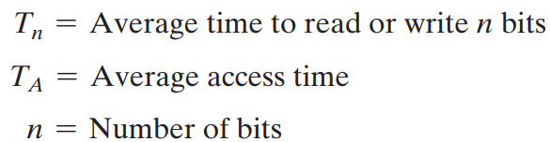
Performance
Access time
Time between presenting the address and getting the valid data
Memory Cycle time
Time may be required for the memory to “recover” before next access
Cycle time is access + recovery
Transfer Rate R
Rate at which data can be moved
①random-access : R=1/(cycle time)
②non-random-access:
Notes:
Tn：读/写n位的平均时间；
Ta：平均存取时间；
N： 数据位数；
R： 传输率，单位b/s；

Slide 15
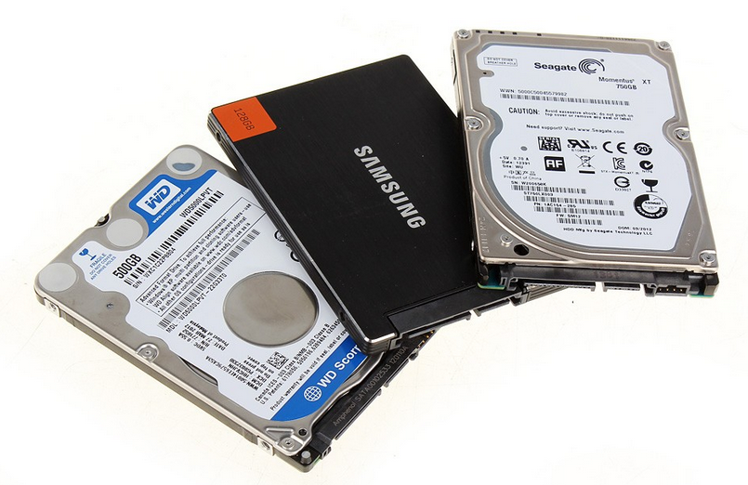
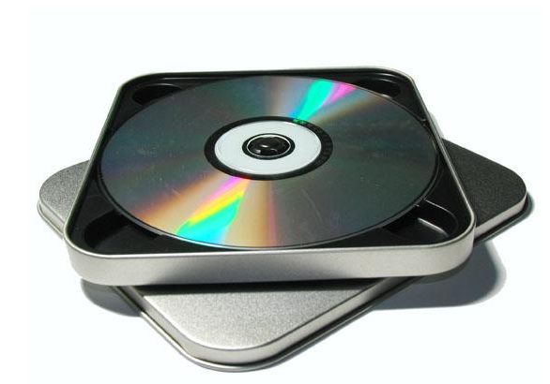
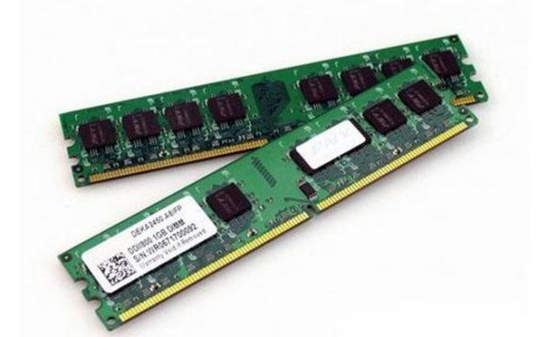

Physical Types
Semiconductor
RAM
Magnetic
Disk & Tape
Optical
CD & DVD
Notes:
半导体
磁表面存储器
光学存储器

Slide 16
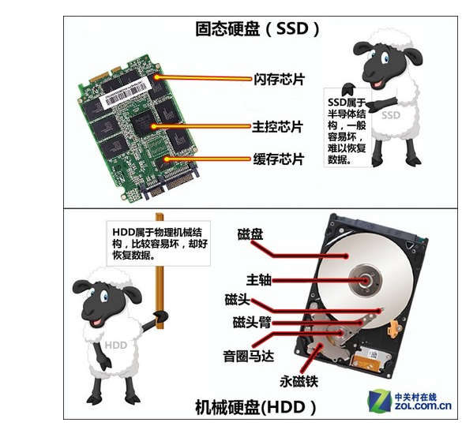
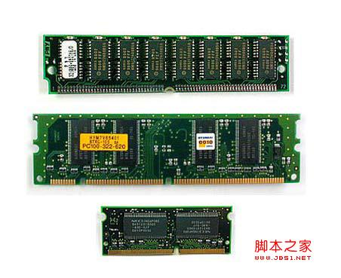

Physical Characteristics
Decay
Volatility
Erasable
Power consumption
Non-volatile
volatile
SSD：DRAM + flash
Notes:
Volatility：易散失性——断电后，信息自动衰减decay，需要依靠电源来维持信息；
Erasable：可擦除性——记录信息可以修改；
固态硬盘：好处，读写速度快，启动快，不拍震动，不容易坏，
ＨＤＤ：５４００／７２００转，

Slide 17
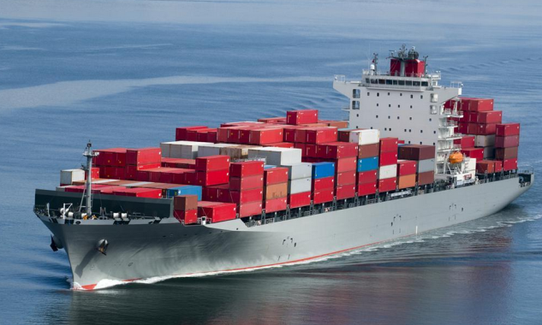


Memory design
How much?
Capacity
How fast?
Time is money
How expensive?
Dilemma:
Faster access time, greater cost per bit
Greater capacity, smaller cost per bit
Greater capacity, slower access time
The way out of the dilemma?
Memory Hierarchy
Notes:
Dilemma困境

Slide 18
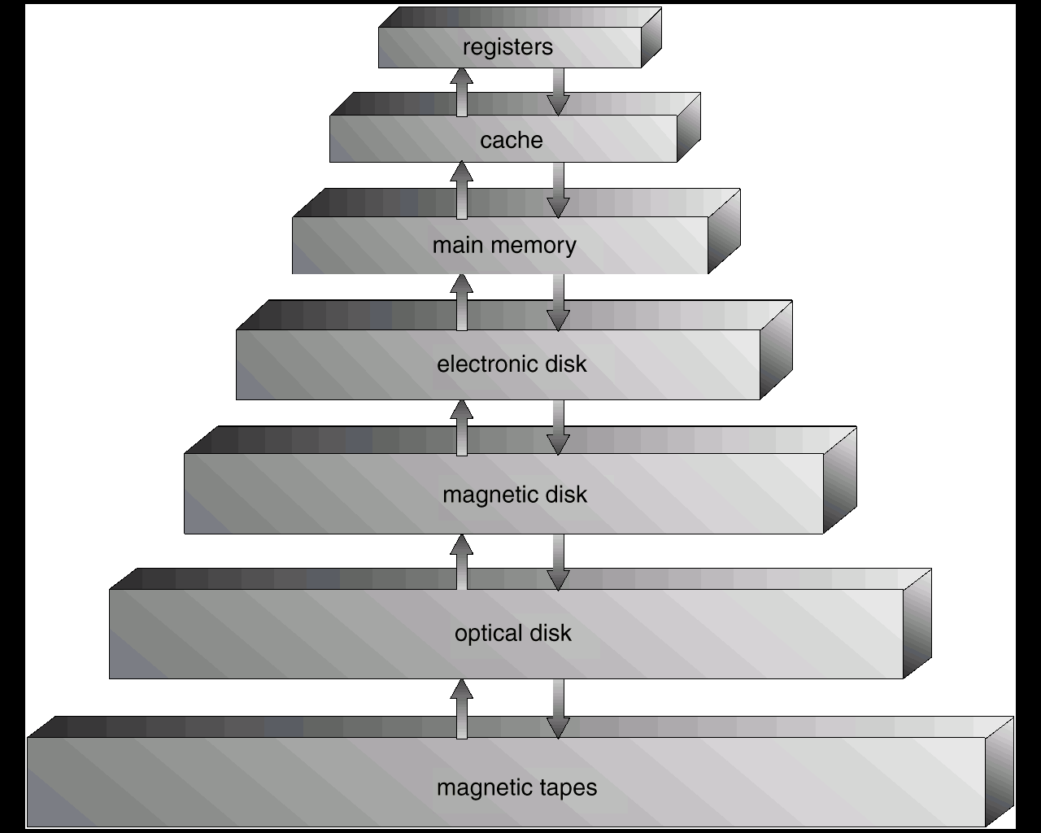
Memory Hierarchy
Registers
In CPU
Internal or Main memory
May include one or more levels of cache
“RAM”
External memory
Backing store

Slide 19
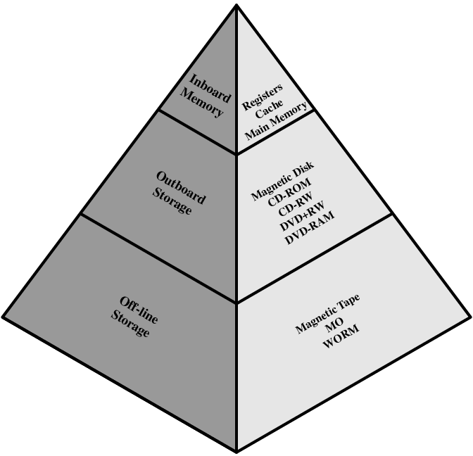
Memory Hierarchy - Diagram
1.Cost per bit?
Decreasing
2.Capacity?
Increasing
3.Access time?
Increasing
4.Frequency of access of the memory by the processor?
Decreasing
: Locality of reference
Notes:
Ｂｏｏｋ 图４．１，

Slide 20
Hierarchy List
Registers
L1 Cache
L2 Cache
Main memory
Disk cache
Disk
Optical
Tape

Slide 21
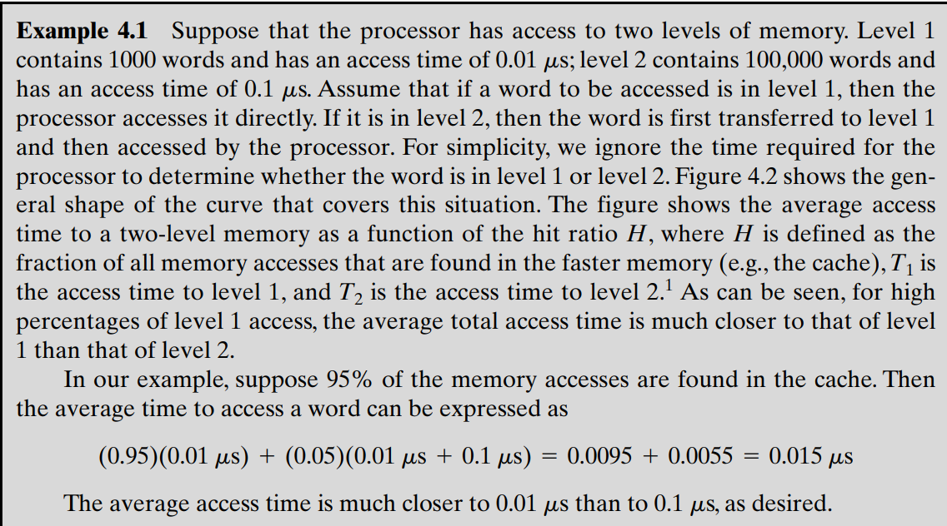
Performance of two-level memory
Notes:
横轴-H（命中率）：在较快的存储器（如cache）中完成存取所占的百分比；（Hit，命中率）(板书公式，参考Appendix 4A.2 和 例题4.1)
纵轴-T：平均存取时间；
T1：较快的存储器平均存取时间；
T2：较慢的存储器平均存取时间；
T1+T2是因为，计算机设计中，总是先从cache中查找（T1），找不到才去2级存储器查找

Slide 22
Performance of two-level memory
T₁+ T₂
T₂
average access time
T₁
H
0
1
(4.2)
T : average (system) access time
T1 : access time of M1 (e.g., cache, disk cache)
T2 : access time of M2 (e.g., main memory, disk)
H : hit ratio (fraction of time reference is found in M1)
Notes:
横轴-H（命中率）：在较快的存储器（如cache）中完成存取所占的百分比；（Hit，命中率）(板书公式，参考Appendix 4A.2 和 例题4.1)
纵轴-T：平均存取时间；
T1：较快的存储器平均存取时间；
T2：较慢的存储器平均存取时间；
T1+T2是因为，计算机设计中，总是先从cache中查找（T1），找不到才去2级存储器查找

Slide 23
Performance of three-level memory
T : average (system) access time
T₁ : access time of M1 (e.g. cache)
T₂ : access time of M2 (e.g., main memory)
T₃: access time of M3 (e.g., disk)
H₁: hit ratio (fraction of time reference is found in M1)
H₂: hit ratio (fraction of time reference is found in M2)
For main memory and disk
T_{avg2}= H₂T₂ +(1-H₂) (T₂+T₃)
For cache
T=T_{avg1}= H₁T₁ +(1-H₁) (T₁+T_{avg2})
= T₁+(1-H₁)[T₂ +(1-H₂) T₃ ]
Notes:
横轴-H（命中率）：在较快的存储器（如cache）中完成存取所占的百分比；（Hit，命中率）(板书公式，参考Appendix 4A.2 和 例题4.1)
纵轴-T：平均存取时间；
T1：较快的存储器平均存取时间；
T2：较慢的存储器平均存取时间；
T1+T2是因为，计算机设计中，总是先从cache中查找（T1），找不到才去2级存储器查找

Slide 24
Performance of three-level memory
T : average (system) access time
T₁ : access time of M1 (e.g. cache)
T₂ : access time of M2 (e.g., main memory)
T₃: access time of M3 (e.g., disk)
H₁: hit ratio (fraction of time reference is found in M1)
H₂: hit ratio (fraction of time reference is found in M2)
Cache | T₁ | H₁
Main Memory | T₁+T₂ | (1-H₁) H₂
Disk | T₁+T₂+T₃ | (1-H₁) (1-H₂)
T= H₁T₁ +(T₁+T₂) (1-H₁) H₂ + (T₁+T₂ +T₃) (1-H₁ ) (1-H₂)
=T₁+(1-H₁)T₂ +(1-H₁) (1-H₂) T₃
Notes:
横轴-H（命中率）：在较快的存储器（如cache）中完成存取所占的百分比；（Hit，命中率）(板书公式，参考Appendix 4A.2 和 例题4.1)
纵轴-T：平均存取时间；
T1：较快的存储器平均存取时间；
T2：较慢的存储器平均存取时间；
T1+T2是因为，计算机设计中，总是先从cache中查找（T1），找不到才去2级存储器查找

Slide 25
Locality of reference (Appendix 4A)
Decreasing frequency of access of the memory by the processor?
=>Locality of reference.
Memory references tend to cluster.
Behaviour of programs
Sequential execution
Few procedures：A program remains confined to a rather narrow window of procedure-invocation depth
Iterative constructs: Most iterative constructs consist of a relatively small number of instructions repeated many times
Arrays or sequences of records
Notes:
两级存储器性能优越性的基础——访问局部性原理；
理由：
-程序大多是顺序执行的，除了分支和调用指令（比例很少，参考教材表4.8）；
-在短时间内，程序通常会限制在较窄的子程序激活窗口内；（procedure指：调用-返回过程，参考第8版教材图4.21）
-迭代结构都是由较少的指令组成，这些指令一般都放在一起，迭代运行期间，程序集中在局部完成；（以循环指令为例，板书循环调用某函数）
-数组/顺序存放的数据，集中在局部，访问具有局部性；
空间局部性原理：存取顺序位置的倾向性；比如顺序取指令PC+1；处理表格数组 for (i=0;i<10;i++) b[i]=0;
时间局部性原理：存取最近位置的倾向性；比如循环指令，重复执行同一个指令，for (i=0;i<10;i++) a=a+1;

Slide 26
Locality of reference (Appendix 4A)
Spatial locality refers to the tendency of execution to involve a number of memory locations that are clustered.
for (i=0;i<10;i++) b[i]=0
Temporal locality refers to the tendency for a processor to access memory locations that have been used recently
for (i=0;i<10;i++) a=a+1
Notes:
两级存储器性能优越性的基础——访问局部性原理；
理由：
-程序大多是顺序执行的，除了分支和调用指令（比例很少，参考教材表4.8）；
-在短时间内，程序通常会限制在较窄的子程序激活窗口内；（procedure指：调用-返回过程，参考第8版教材图4.21）
-迭代结构都是由较少的指令组成，这些指令一般都放在一起，迭代运行期间，程序集中在局部完成；（以循环指令为例，板书循环调用某函数）
-数组/顺序存放的数据，集中在局部，访问具有局部性；
空间局部性原理：存取顺序位置的倾向性；比如顺序取指令PC+1；处理表格数组 for (i=0;i<10;i++) b[i]=0;
时间局部性原理：存取最近位置的倾向性；比如循环指令，重复执行同一个指令，for (i=0;i<10;i++) a=a+1;

Slide 27
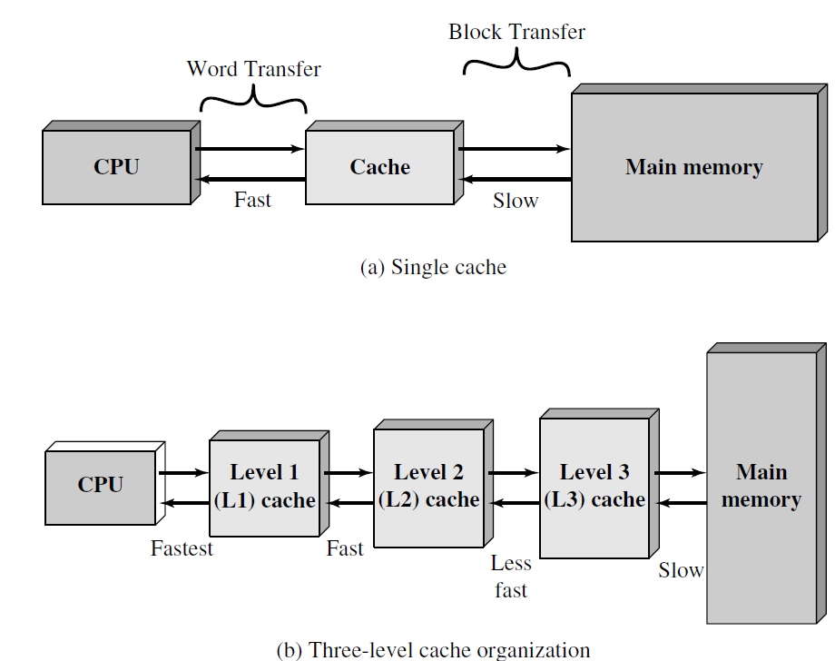
4.2 Cache memory principles
Small amount of fast memory
Sits between normal main memory and CPU
May be located on CPU chip or module
Small, fast
Large, slow
Notes:
Catch:高速缓存

Slide 28
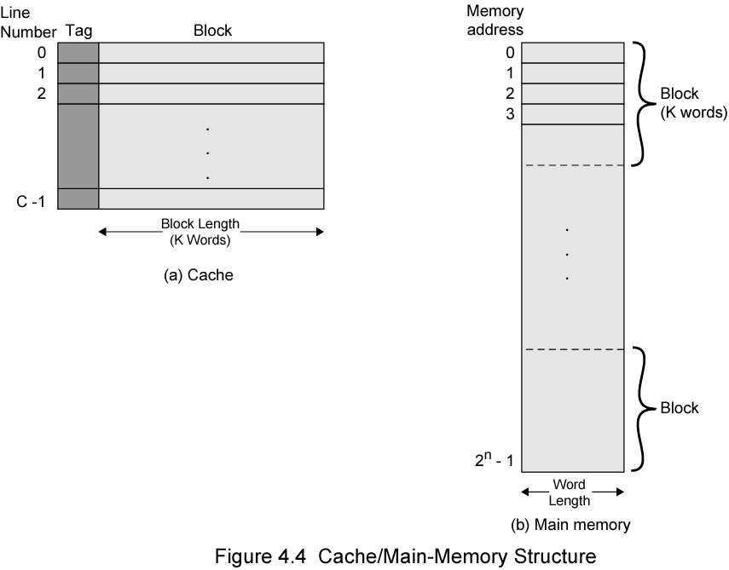
Cache/Main Memory Structure
No. of Blocks : M=2^{n}/K
No. of lines : C << M
Notes:
Fig 4.4
Tag：标记——Main Mem的块数（block）多于Cache的行数（line），因此通过tag位来标识，是main mem中的哪个数据块；
板书公式： M=2^n/K ;C<<M

Slide 29
Cache operation – overview
CPU requests contents of memory location
Check cache for this data
If present, get from cache (hit)
If not present (miss), read required block from main memory to cache Then deliver from cache to CPU
Cache includes tags to identify which block of main memory is in each cache slot

Slide 30
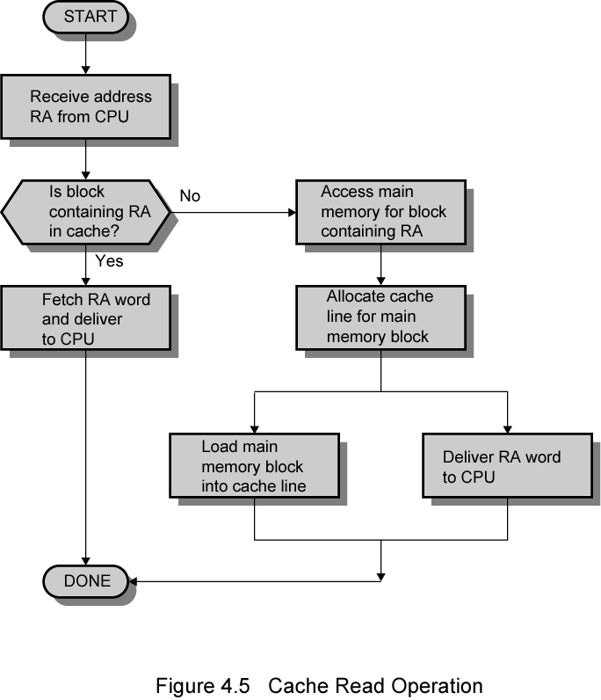
Cache Read Operation - Flowchart
Parallel operation
Notes:
Fig 4.5
右边最后两个操作并行出现

Slide 31
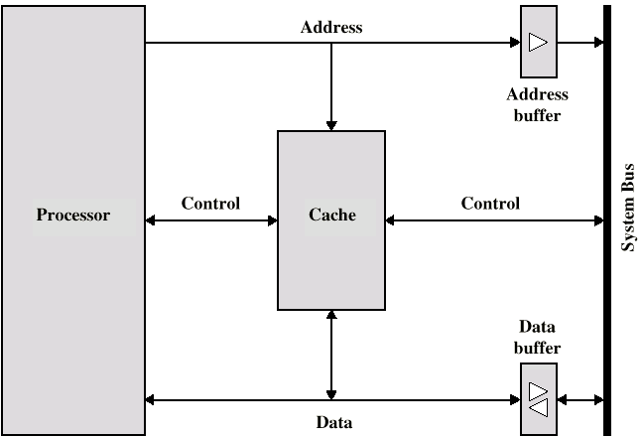
Typical Cache Organization
Hit
Notes:
Fig 4.6 典型cache组织
Cache hit： 两个buffer 关闭
Cache miss： 所要求地址加载到system Bus，数据通过buffer返回给cache和processor
其他组织中，cache miss时，数据块先入cache，再由cache传给processor

Slide 32

Typical Cache Organization
Miss
Notes:
Fig 4.6 典型cache组织
Cache hit： 两个buffer 关闭
Cache miss： 所要求地址加载到system Bus，数据通过buffer返回给cache和processor
其他组织中，cache miss时，数据块先入cache，再由cache传给processor

Slide 33
4.3 Elements of Cache Design
Cache Addresses
Size
Mapping Function
Replacement Algorithm
Write Policy
Block Size
Number of Caches

Slide 34
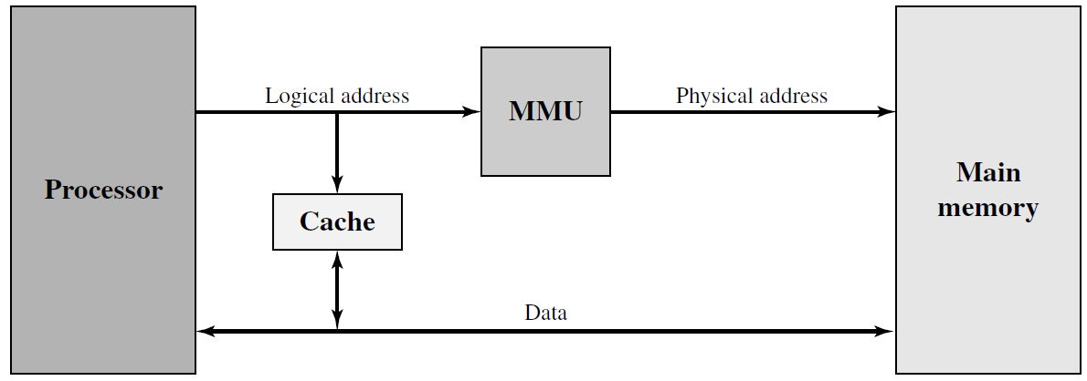
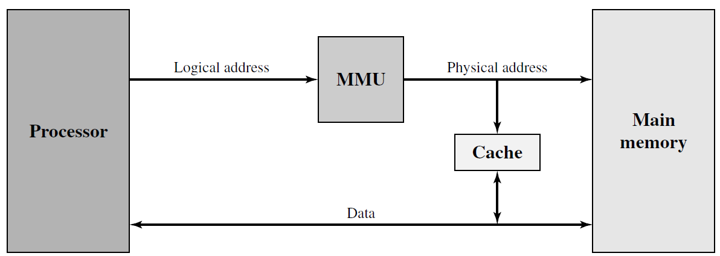
Cache Addresses
Memory Management Unit
Logical/Virtual cache
Faster
Add switch or bits
Physical cache
Notes:
大多CPU支持虚拟内存，利用MMU把virtual address翻译成physical address
Logical cache 优点：faster
缺点：add switch or bits 不同的应用程序虚拟地址都是0开始，但是对应于不同的物理地址，
Cache必须利对不同应用程序，用开关刷新，或在每一cache line增加bits来标记是哪个虚拟地址。

Slide 35
Size does matter
Cost
Speed
More cache is expensive
More cache is faster
Checking cache for data takes time
The available chip and board area also limits cache size.
No optimum cache size.
Notes:
Cache的设计要素
Cache 容量：希望cache小-〉price/bit接近主存；
希望cache大-〉平均存取时间接近于单个cache，寻址电路越复杂。
没有最优的容量。

Slide 36
Comparison of Cache Sizes
Processor
Type
Year of Introduction
L1 cachea
L2 cache
L3 cache
IBM 360/85
Mainframe
1968
16 to 32 KB
—
—
PDP-11/70
Minicomputer
1975
1 KB
—
—
VAX 11/780
Minicomputer
1978
16 KB
—
—
IBM 3033
Mainframe
1978
64 KB
—
—
IBM 3090
Mainframe
1985
128 to 256 KB
—
—
Intel 80486
PC
1989
8 KB
—
—
Pentium
PC
1993
8 KB/8 KB
256 to 512 KB
—
PowerPC 601
PC
1993
32 KB
—
—
PowerPC 620
PC
1996
32 KB/32 KB
—
—
PowerPC G4
PC/server
1999
32 KB/32 KB
256 KB to 1 MB
2 MB
IBM S/390 G4
Mainframe
1997
32 KB
256 KB
2 MB
IBM S/390 G6
Mainframe
1999
256 KB
8 MB
—
Pentium 4
PC/server
2000
8 KB/8 KB
256 KB
—
IBM SP
High-end server/ supercomputer
2000
64 KB/32 KB
8 MB
—
CRAY MTAb
Supercomputer
2000
8 KB
2 MB
—
Itanium
PC/server
2001
16 KB/16 KB
96 KB
4 MB
SGI Origin 2001
High-end server
2001
32 KB/32 KB
4 MB
—
Itanium 2
PC/server
2002
32 KB
256 KB
6 MB
IBM POWER5
High-end server
2003
64 KB
1.9 MB
36 MB
CRAY XD-1
Supercomputer
2004
64 KB/64 KB
1MB
—
a Two values seperated by a slash refer to instruction and data caches
b Both caches are instruction only; no data caches

Slide 37
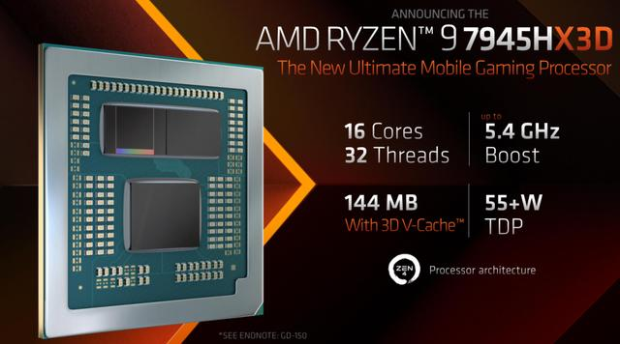
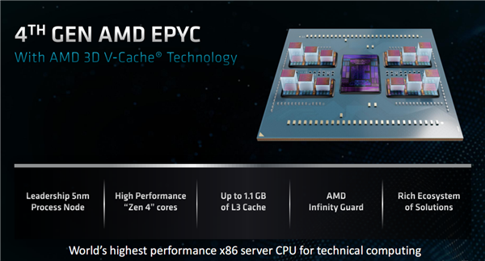
3D V cache-缓存垂直堆叠
AMD R9-7945HX3D
基于Zen4核心架构，双CCD设计，实现了16核32线程的搭配，加速频率5.4GHz，L3缓存高达128MB，L2+L3缓存量达到了144MB
EPYC 9684X：
96核心192线程，频率2.55-3.7GHz，三级缓存1152MB(384MB＋768MB)，默认TDP 400W，可调范围320-400W
Notes:
3D V-Cache是AMD开发的一项新技术，采用业界首创的Hybrid bond加穿透硅通孔技术（TSV）工艺（互连密度是2D小芯片的200倍多，是现有3D堆叠方案的15倍多），可以让L3缓存垂直堆叠，在不改变处理器面积的前提下，可用L3缓存（SRAM）总数增加三倍。

Slide 38
Mapping Function
Direct
Associative
Set associative
Notes:
映射的概念来自数学；
映射算法： 主存较多的block-〉cache较少的line

Slide 39
Mapping Function
line 0
line 1
line 2
line 3
Notes:
俗话说:“没有规矩,不成方圆”，这里的规矩就是mod

Slide 40
Mapping Function
Notes:
生命诚可贵 爱情价更高 若为自由故 两者皆可抛。匈牙利诗人裴多菲的诗歌《自由与爱情》
电影《勇敢的心》最后一句台词“freedom”。
缺点：需要复杂电路来并行检查全部高速缓存行的标签。

Slide 41
Mapping Function
Set associative
Notes:
古代儒家思想中，一个重要的思想“中庸之道”。

Slide 42
Mapping example
Cache can hold 64kByte
Cache block of 4 bytes
i.e. cache is 16k (2¹⁴) lines of 4 bytes
16MBytes main memory
24 bit address
i.e. 2²⁴=16M
Notes:
注：二进制中 2^10=1k, 2^20=1M;
板书示意
16k（2^14）行的Cache，每行一个block（4 bytes）；
16M（2^24）行的main mem，每行一个byte，每4行一个block，共有4M（2^22）个block；

Slide 43
Direct Mapping
Each block of main memory maps to only one cache line
i.e. if a block is in cache, it must be in one specific place
Address is in two parts
Least Significant w bits identify unique word or byte
Most Significant s bits specify one memory block
The MSBs are split into a cache line field r and a tag of s-r (most significant)

Slide 44
Direct Mapping Address Structure
24 bit address (main memory)
2 bit word identifier (4 byte block)
22 bit block identifier
8 bit tag (=22-14)
14 bit slot or line (Cache line number)
No two blocks in the same line have the same Tag field
Check contents of cache by finding line and checking Tag
C662E3:
110001100110001011100011

Slide 45
Direct Mapping function
i = cache line number
j = [0, 2^{s}-1] main memory block number
m =2^{r} number of lines in the cache

Slide 46
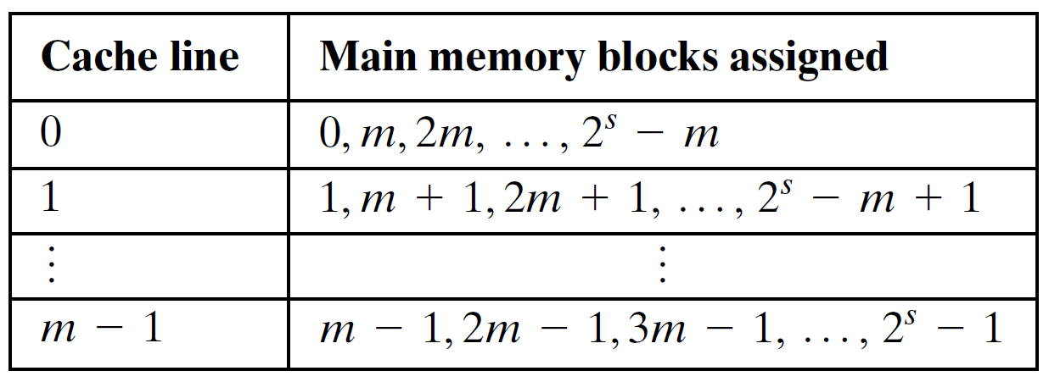
Direct Mapping Cache Line Table
m=4
Cache line number | Block number
0 | B₀, B₄, B₈
1 | B₁, B₅, B₉
2 | B₂, B₆, B₁₀
3 | B₃, B₇, B₁₁

Slide 47
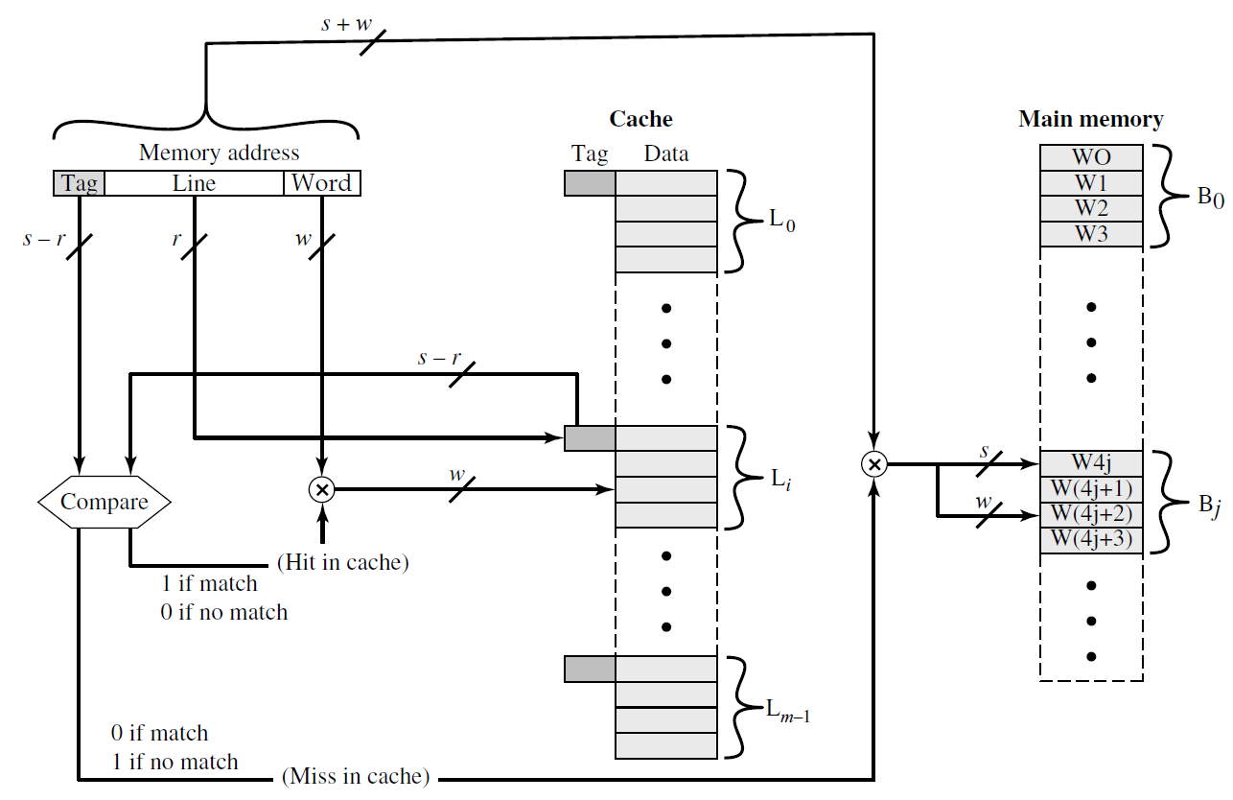
Direct Mapping Cache Organization
Notes:
Fig 4.9

Slide 48
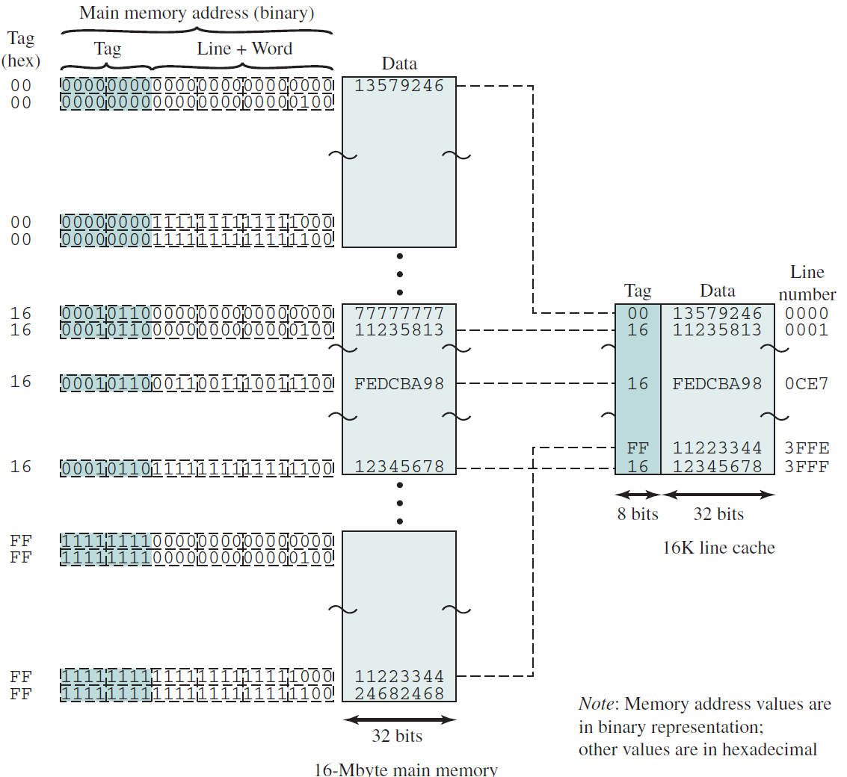
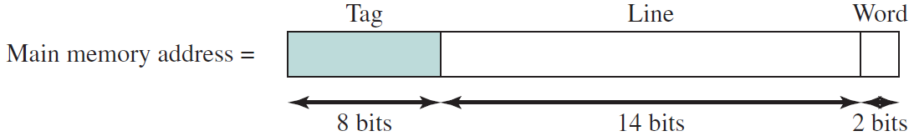
Direct Mapping Example
000101100011001110011100
Notes:
Fig 4.8
首先分清 地址/数据；

Slide 49
Direct Mapping Summary
Address length = (s + w) bits
Number of addressable units = 2^{s+w} words or bytes
Block size = line size = 2^{w} words or bytes
Number of blocks in main memory = 2^{s+ w} /2^{w} = 2^{s}
Number of lines in cache = m = 2^{r}
Size of tag = (s – r) bits

Slide 50
Advantages and disadvantages of Direct Mapping
Adv.
Simple
Inexpensive
Disadv.
Fixed location for given block (cache thrashing 颠簸/乒乓)
If a program accesses 2 blocks that map to the same line repeatedly, cache misses are very high
One solution.
Victim Cache:4-16 cache lines, fully associative

Slide 51
Associative Mapping
A main memory block can load into any line of cache
Memory address is interpreted as tag and word
Tag uniquely identifies block of memory
Every line’s tag is examined for a match
Cache searching gets expensive
Notes:
关联映射
Expensive：
Hardware complex
Time consuming

Slide 52
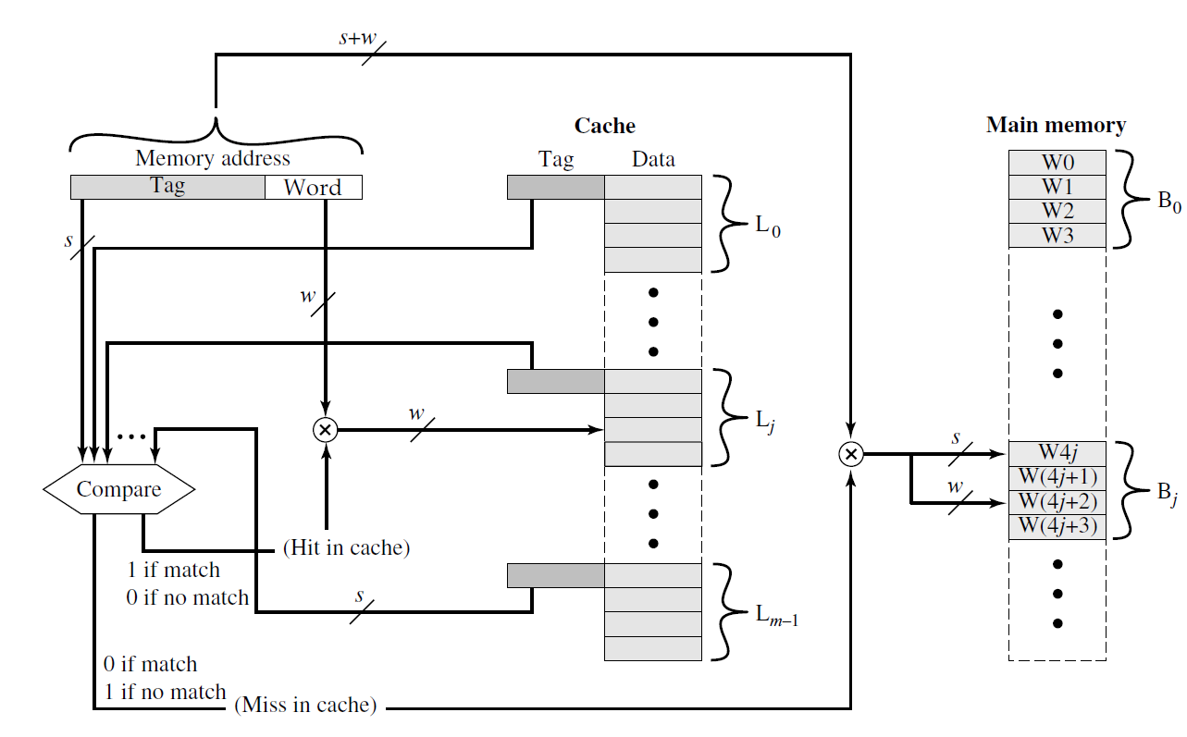
Fully Associative Cache Organization
Notes:
图4.9
全关联cache组织

Slide 53
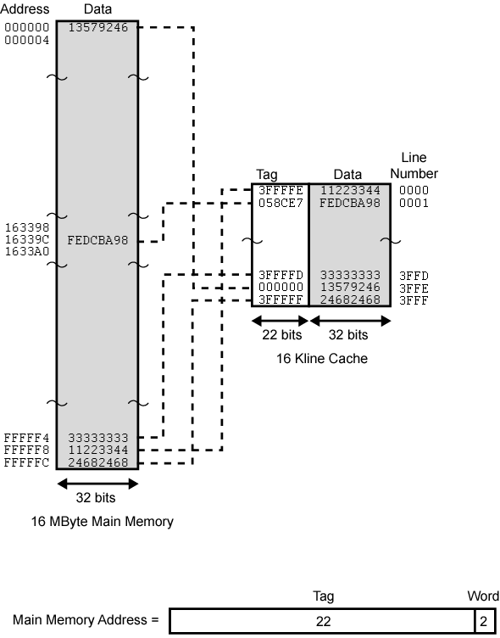
Associative Mapping Example
Tag：0x3FFFFF
Notes:
FFFFF8/4=3FFFFE
FFFFFC/4=3FFFFF

Slide 54
Associative Mapping Address Structure
22 bit tag stored with each 32 bit block of data （1 by 1）
Compare tag field with tag entry in cache to check for hit
Least significant 2 bits of address identify which 8-bit byte is required from 32 bit data block

Slide 55
Associative Mapping Summary
Address length = (s + w) bits
Number of addressable units = 2^{s+w} words or bytes
Block size = line size = 2^{w} words or bytes
Number of blocks in main memory = 2^{s+} ^{w} /2^{w} = 2^{s}
Number of line in cache associated to main memory = undetermined
Size of tag = s bits

Slide 56
Set Associative Mapping
Cache is divided into a number of sets
Each set contains a number of lines
Lines->sets->cache
A given block maps to any line in a given set
e.g. Block B can be in any line of set i
e.g. 2 lines per set
2 way associative mapping
A given block can be in one of 2 lines in only one set
i = cache set No.
j = main memory block No.
m = number of lines in the cache
(Cache size in lines)
v = number of sets in the cache
(Cache size in sets)
Notes:
组相关映射
Line-cache
Line-set-cache

Slide 57
Set Associative Mapping
k-way associative mapping (k=2, v=4)
No. of lines in the cache: m=v×k=8
No. of sets in the cache : v=4
Cache Set No. : i=j mod 4

Slide 58
Set Associative Mapping Address Structure
Use set field to determine cache set to look in
Compare tag field to see if we have a hit
e.g
Address Tag Data Set number
0xFFFFFC 1FF 12345678 1FFF
0x00FFFC 001 11223344 1FFF
Address 0xFFFFFC： 1111 1111 1111 1111 1111 1100
Address 0x00FFFC： 0000 0000 1111 1111 1111 1100

Slide 59
Set Associative Mapping Example
13 bit set number
2 lines per set
Block number in main memory is modulo 2¹³
002000, 00A000, 012000, 01A000,… FF2000, FFA000 … map to same set 0800
00A000H = 0000 0000 1010 0000 0000 0000 B
主存地址所在block number = 00A000H/4 = 2800H
对应cache set number= 2800H mod 2000H = 800H
对于tag = 1
Notes:
地址0x002000/4=0x800
0x800 mod 0x2000=0x800

Slide 60
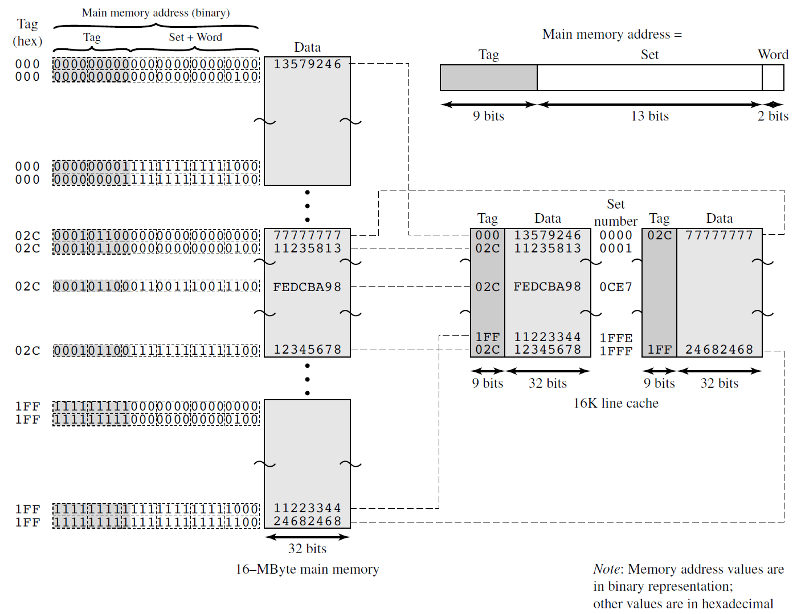
Two-Way Set Associative Mapping
0xFFFFFC
Notes:
首先，对main mem进行划分，对组数set No取模；每个小块可以对应完整的一路；
Main mem中每个小块的第i行就对应cache中的第i组，这是确定的determined；
至于第i组中的第几路是不确定的，
需要tag来确定是否hit；

Slide 61
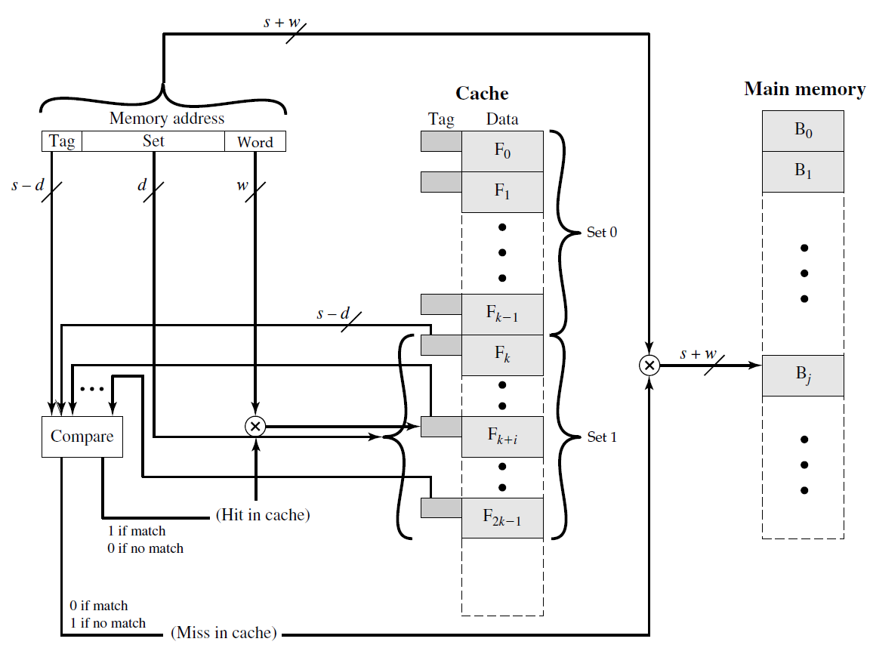
K-Way Set Associative Cache Organization
Notes:
图4.11
K路，表示每个set中有k行，每次比较tag位的时候只需要比较这k行就可以了；

Slide 62
Set Associative Mapping Summary
Address length = (s + w) bits
Number of addressable units = 2^{s+w} words or bytes
Block size = line size = 2^{w} words or bytes
Number of blocks in main memory = 2^{s}
Number of lines in one set = k
Number of sets = v = 2^{d}
Number of lines in cache = kv = k * 2^{d}
Size of tag = (s – d) bits

Slide 63
Relationships of mappings
Set Associative Mapping → Direct mapping
when v=m and k=1
Set Associative Mapping → Associative Mapping
when v=1 and k=m
k-way：No. of lines in one set
v: No. of sets
m: No. of lines in the cache
Notes:
2路组相关映射，提高命中率的思考：
为两条可能被频繁调用，而又具有同一组号（set number）的指令提供了同时位于cache 的可能；避免了direct map中需要反复访问内存的情况；
4路组相关，只是提高了一些；再增加组数，已经基本不提高性能了；

Slide 64
Relationships of mappings
Notes:
2路组相关映射，提高命中率的思考：
为两条可能被频繁调用，而又具有同一组号（set number）的指令提供了同时位于cache 的可能；避免了direct map中需要反复访问内存的情况；
4路组相关，只是提高了一些；再增加组数，已经基本不提高性能了；

Slide 65
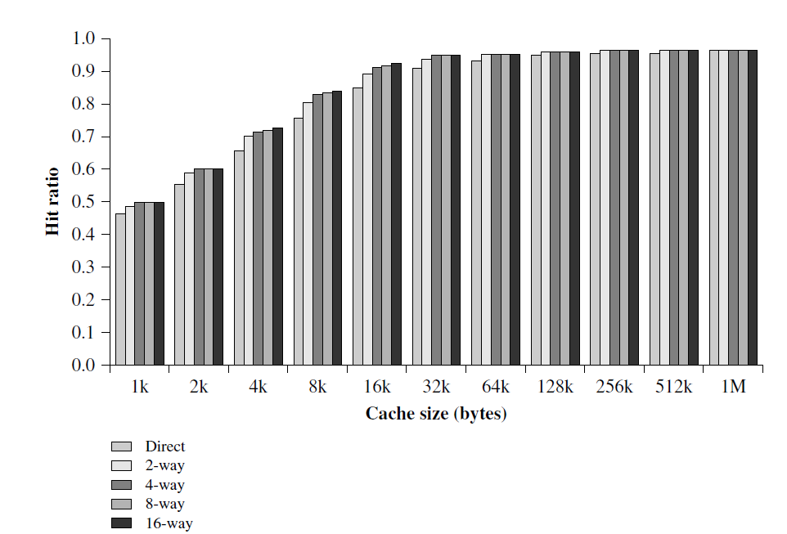
Varying Associativity over Cache Size
K=2 is the most common set associative organization => hit improvement
K=4 makes a modest additional improvement
one simulation study of set-associative cache
performance as a function of cache size
Notes:
Cache size 增大到32k bytes后hit ratio没有明显提高了。

Slide 66
Replacement Algorithms (1) Direct mapping
Each block only maps to one line
Replace that line
No choice

Slide 67
Replacement Algorithms (2) Associative & Set Associative
Least Recently used (LRU)
e.g. in 2 way set associative, Which of the 2 block is lru?
First in first out (FIFO)
replace block that has been in cache longest
Least frequently used(LFU)
replace block which has had fewest hits
Random
Slightly inferior performance to usage based algorithms
Notes:
Least recently used (LRU): Replace that block in the set that has been in the cache longest
with no reference to it.

Slide 68
Replacement Algorithms (2) Associative & Set Associative
LRU
FIFO

Slide 69
Write Policy
Must not overwrite a cache block unless main memory is up to date
Two cases to be considered.
CPU wants to read a byte from 0x0010 or 0x0068.
0x0010
0x0068
Notes:
旧块在Cache被修改，则主存也必须同步修改后，新块才能去cache替换旧块；

Slide 70
Write Policy
Problems：
I/O may address main memory directly.
More complex problems occurs when multiple CPUs may have individual caches
Notes:
Cache被修改，则主存也必须同步修改后，才能替换该cache；

Slide 71
Write through
All writes go to main memory as well as cache
Multiple CPUs can monitor main memory traffic to keep local (to CPU) cache up to date
->Disadv：
Lots of traffic
Slows down writes

Slide 72
Write back
Updates initially made in cache only
Update bit for cache slot is set when update occurs
If block is to be replaced, write to main memory only if dirty/update bit is set
I/O must access main memory through cache
-> keep single cache & main memory coherent
Notes:
Update在cache中完成，并有set位标记，以确定是否写回main mem；

Slide 73
Write back example
CPU wants to read a byte from 0x0000. Cache miss.

Slide 74
Cache coherency
Bus watching with write through
Hardware transparency(additional hardware to keep caches &main memory coherency)
Noncacheable memory
-> keep multiple cache & main memory coherent
②
①
Notes:
第一张图：多个cache共享主存总线，某个cache字被修改的话，其他cache中这个字与主存中这个字就无效。

Slide 75
Line size
As the block size increase, hit ratio increase first, then decrease
8-64 bytes seems reasonably
64 and 128 byte cache line sizes are most frequently used for HPC
Notes:
没有确定的值，当块太大时，导致替换，从而hit降低；

Slide 76
Number of caches
Multilevel caches
On chip cache speed up execution
Off chip cache is still desirable
Unified versus split caches
Unified cache: only one cache, balance the load between instruction and data fetches,
Split cache: One dedicated to instructions and one dedicated to data, suitable for pipeline execution.
The trend is toward split caches at the L1 and unified caches for higher levels.

Slide 77
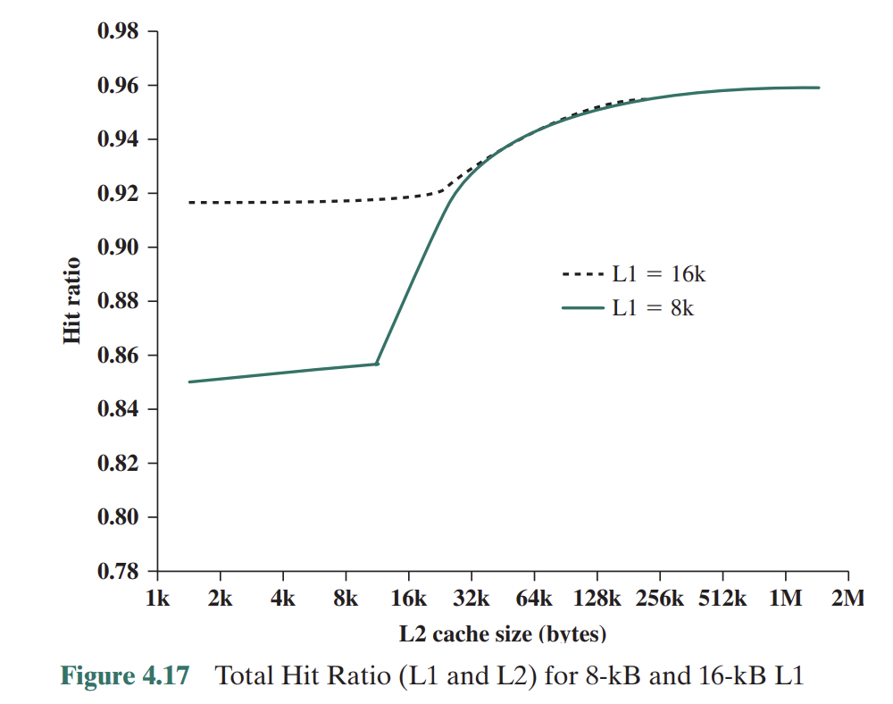
Number of caches
L2 has little effect on the total number of cache hits until it is at least double the L1 cache size.
Assume that both caches have the same line size.

Slide 78
Homework
1. Reading book
2. Key Terms 翻译
3. Review Questions : 1,2,3
4. Problems: 5,6,7,8,11,22
ps：中文答题

